Slide 1
Cricket Player Performance Prediction System
Presented by: Sinchana K

Slide 2
The Challenge: Cricket Analysis
Cricket performance prediction presents challenges such as:
Handling high-volume ball-by-ball datasets
Extracting meaningful time-series features
Avoiding data leakage in model training
Capturing contextual factors (venue, opposition, player form)
Ensuring model generalization across seasons
Traditional statistical methods fail to capture:
Non-linear relationships
Rolling performance trends
Contextual interactions
Hence, a scalable ML-based predictive framework is essential.

Slide 3
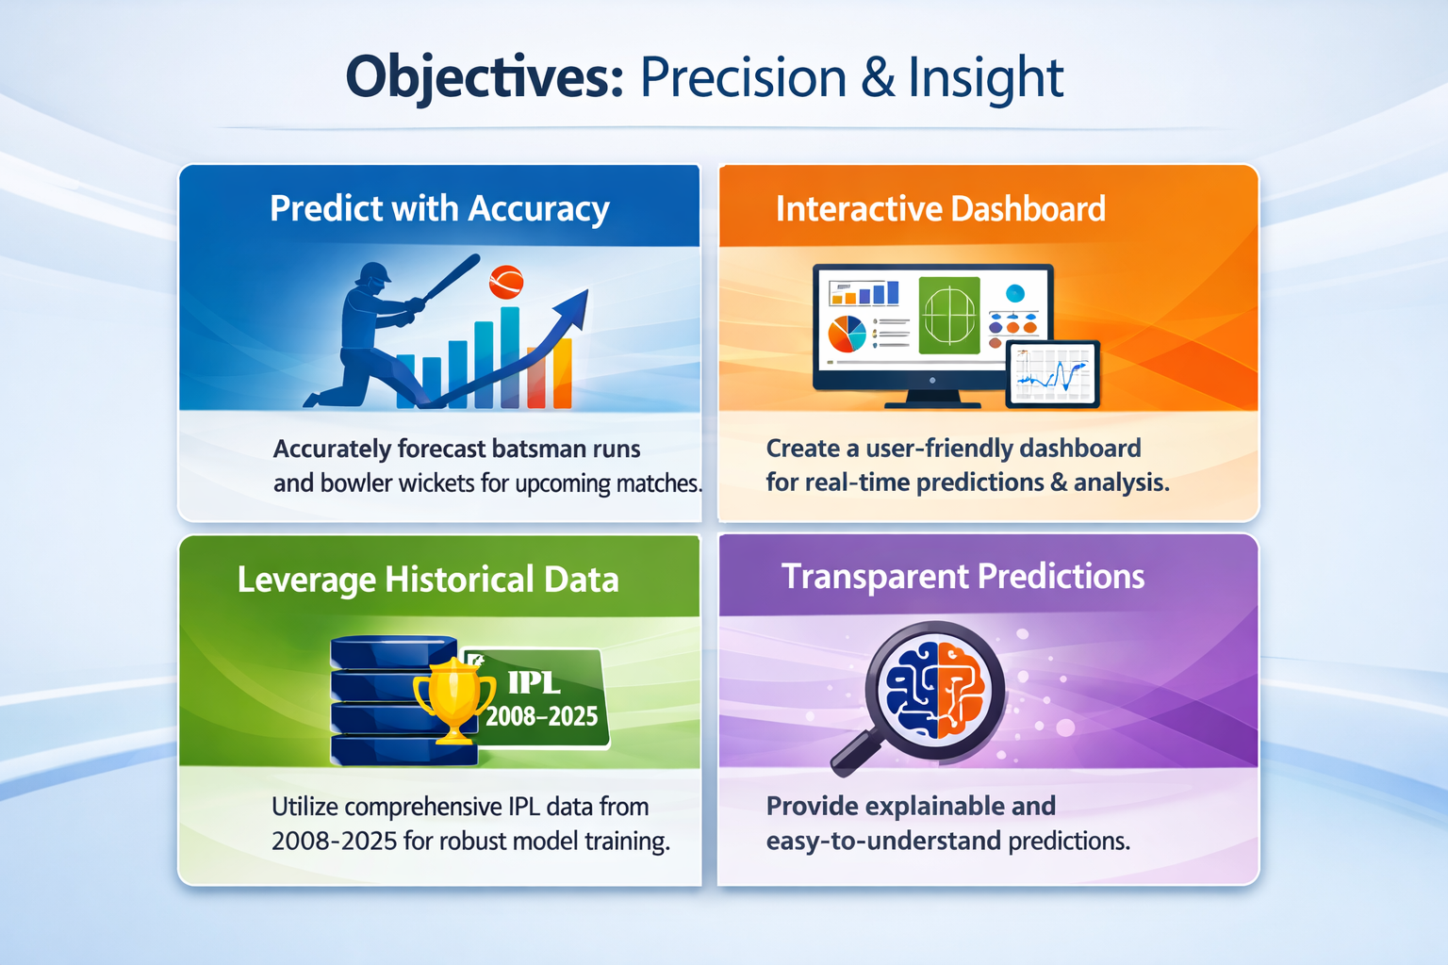
Product overview
Combining functionality and user-friendliness, we empower users to streamline operations and boost efficiency

Slide 4
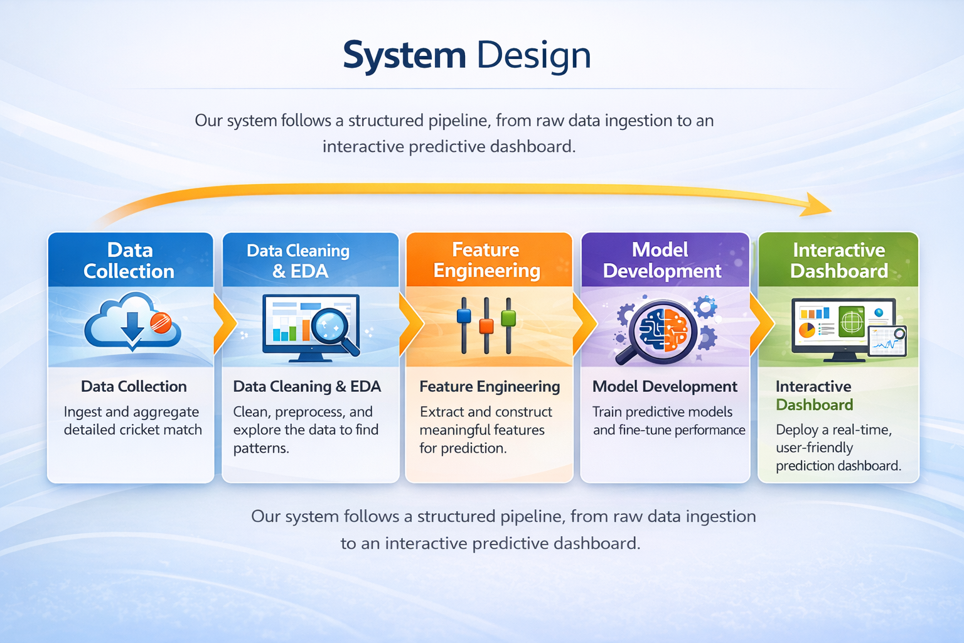

Slide 5
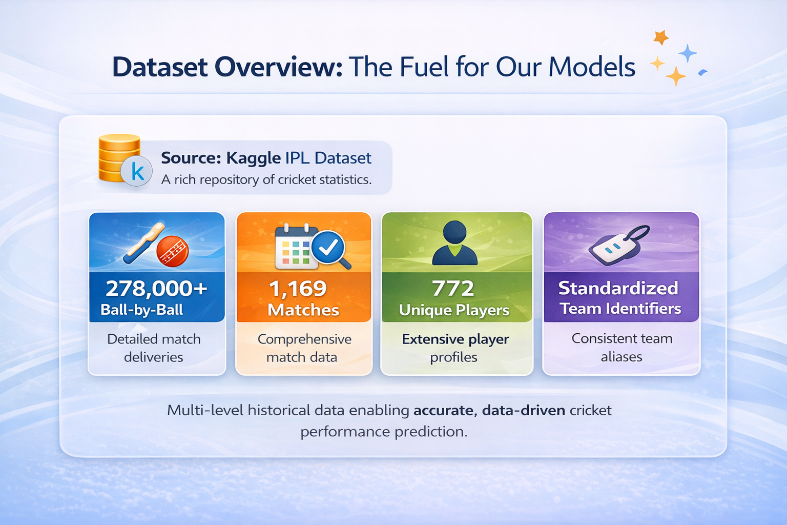
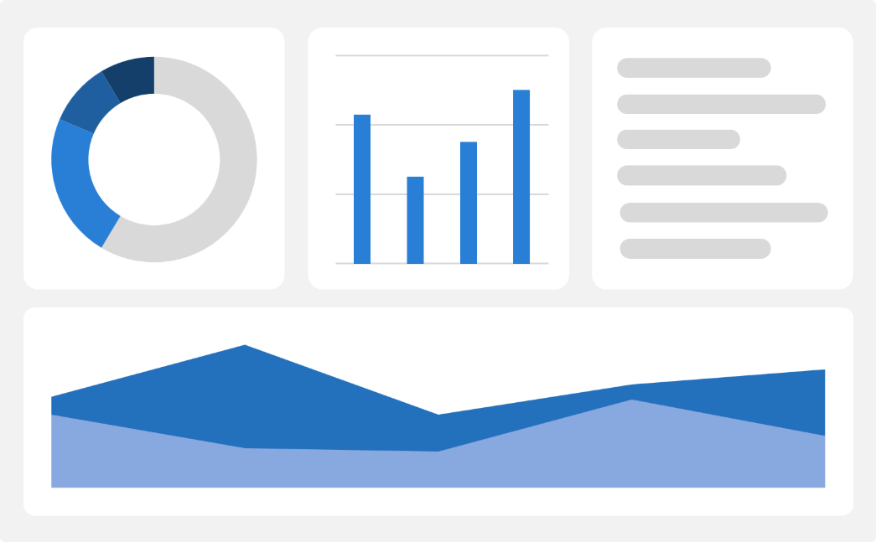
Dataset Overview: The Fuel for Our Models
Source: Kaggle IPL Dataset
🏏 278,000+ Ball-by-Ball Records
📋 1,169 Match Records
👤 772 Unique Players
🏷 Standardized Team Identifiers
Why It Matters: Multi-level historical data enabling accurate, data-driven cricket performance prediction.

Slide 6
Data Refinement & Exploratory Insights
Data Cleaning & Preparation
Removed duplicate records
Handled missing values carefully
Standardized team and player names
Converted dates and numbers into proper formats
Created useful columns like wicket indicator
Result: A clean and structured dataset ready for model training.
Remove Duplicates
Handle Missing Values
Standardize & Format Data
Ensured consistent names and converted dates/numbers into proper format.
Deleted repeated records to improve data accuracy.
Filled or removed missing data for better analysis.

Slide 7
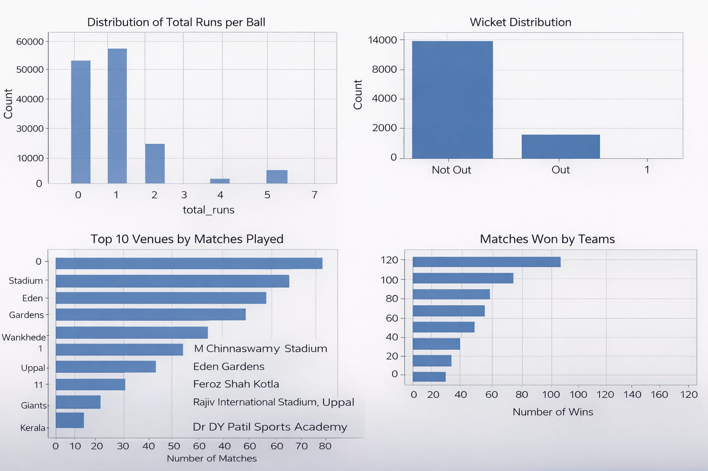
Exploratory Data Analysis (EDA): Uncovering Patterns
Performed Exploratory Data Analysis (EDA) to understand data patterns, identify trends, detect outliers, and analyze relationships between key performance features.

Slide 8
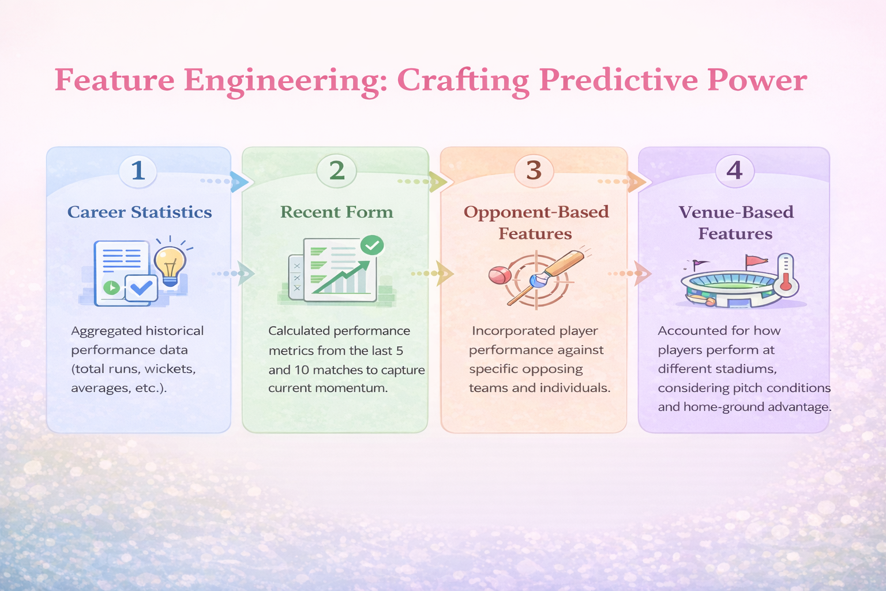

Slide 9
Model Selection & Training
Models Used
We selected strong ensemble models for accurate prediction:
Random Forest – Improves stability using multiple decision trees
XGBoost – Efficient gradient boosting framework
Baseline Model – Used for performance comparison
Training Approach
Performed regression to predict continuous values (runs & wickets)
Applied Hyperparameter Tuning using Grid Search & Random Search
Total training time: ~12 minutes
Model | RMSE | MAE | R² Score
Baseline | 22.34 | — | —
Random Forest | 20.87 | 15.59 | 0.11
XGBoost | 21.11 | 15.73 | 0.09

Slide 10
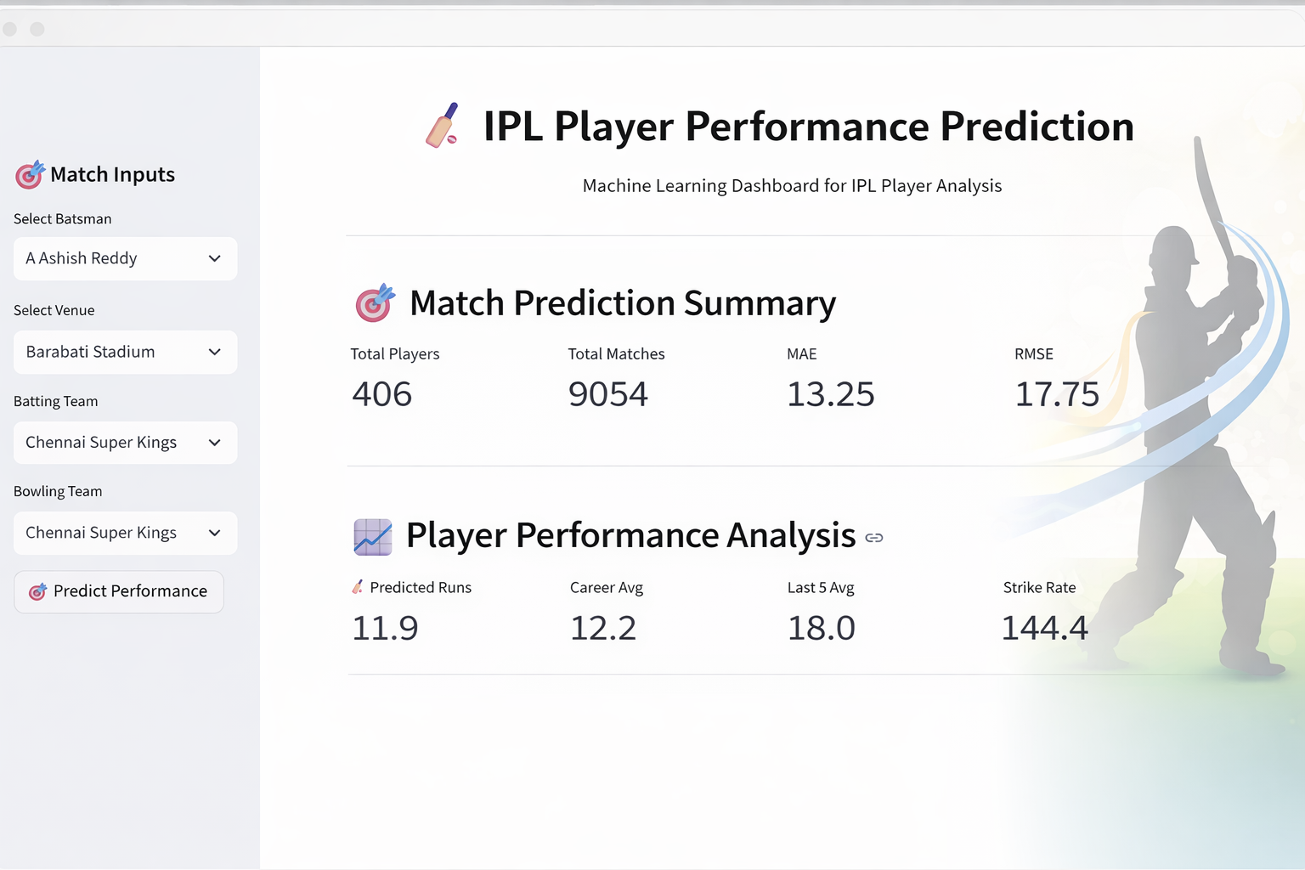
Interactive Dashboard Features

Slide 11
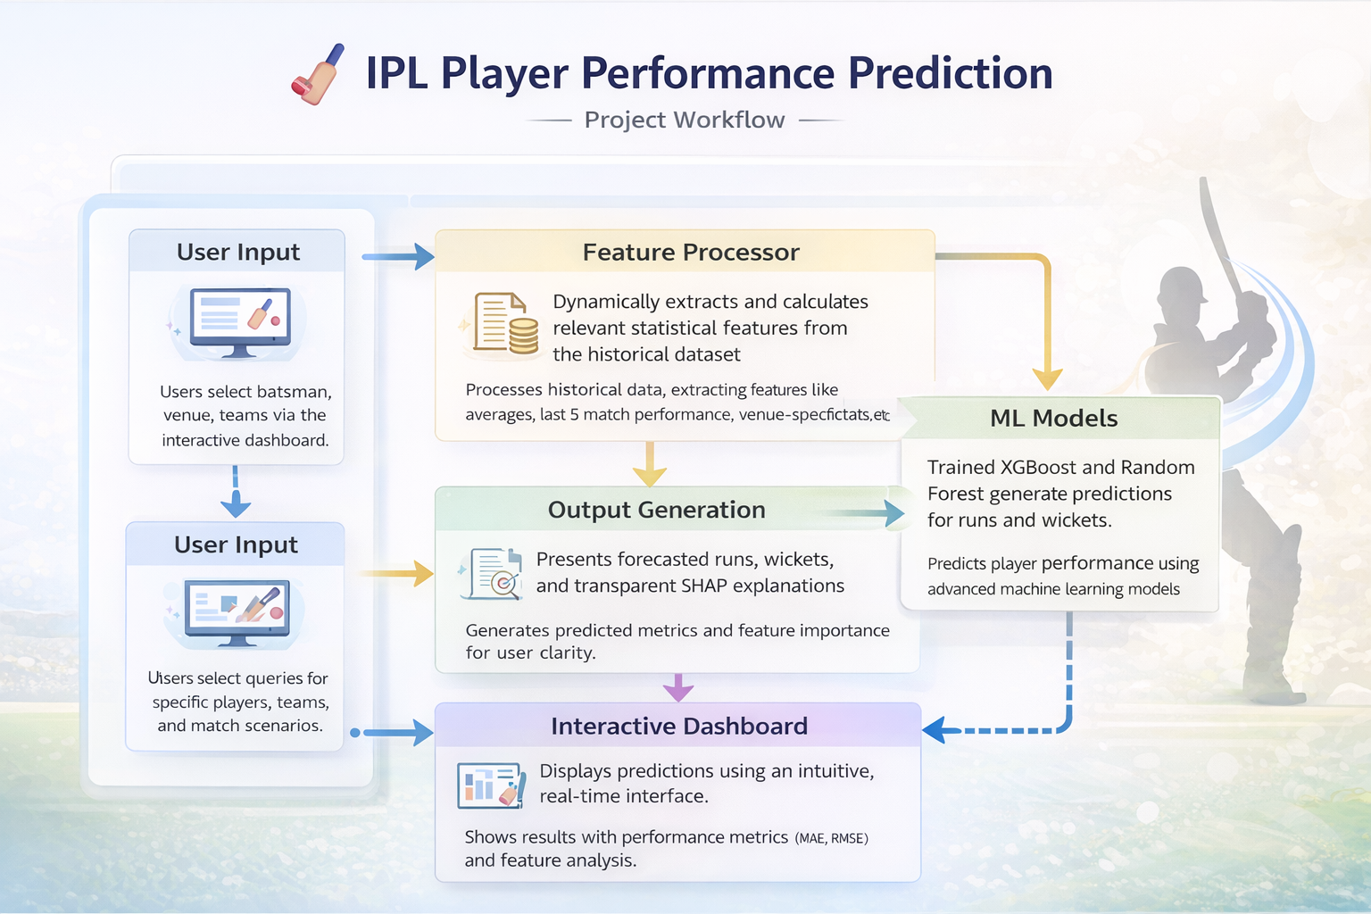

Slide 12
Conclusion
Successfully developed an AI-based system to predict batsman runs and bowler wickets
Implemented complete ML pipeline: data cleaning, EDA, feature engineering, model training & evaluation
XGBoost selected for batsman prediction and Random Forest for bowler prediction based on performance
Integrated trained models into an interactive Streamlit dashboard
System delivers fast, accurate, and explainable predictions using SHAP
Supports data-driven decision making in IPL analytics

